Slide 1
WHO Cigarette and Tabacco Consumption
Data Dancers
Neal Bhatia, Katia Gonzalez, Nikola Jankovic, Parris W, Stas Mruz
Notes:
Katia

Slide 2

Background
Lung cancer is the leading cause of cancer deaths worldwide and 90 percent of all cases are caused by cigarette smoking.
It kills 1.2 million people a year and about 15 percent of smokers develop lung cancer.
By using data from the World Health Organization and applying a machine learning model, we wanted to see how accurately our model predicts cigarette consumption.
Notes:
Katia

Slide 3
Technology Applications Used
Sckit-learn
Jupyter Notebook / Pandas
Javascript
HTML/CSS/Bootstrap
Heroku
SQL
AWS
Notes:
Parris

Slide 4
Steps to Building a Machine Learning Model
Scraped WHO Smoking Data
Preprocessing Data
Training Data ('12, '14, '16)
Testing Data ('18)
Logistic Regression Random Forest
Notes:
Stas

Slide 5
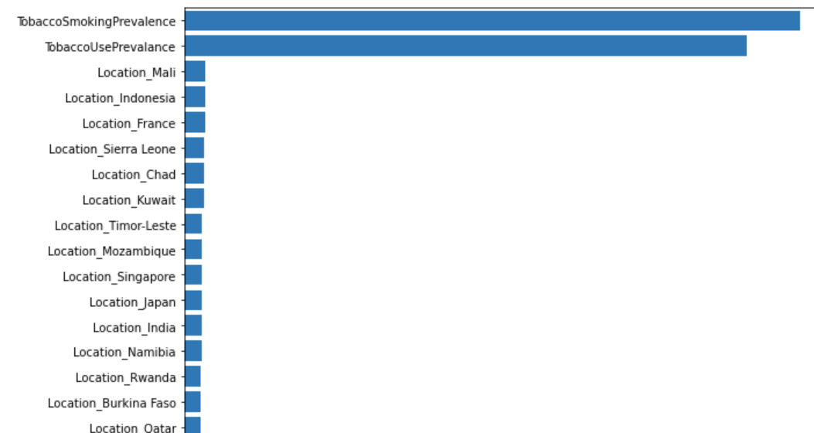
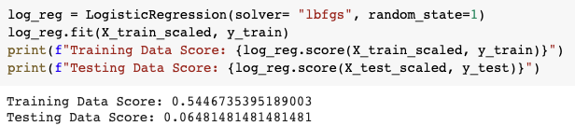
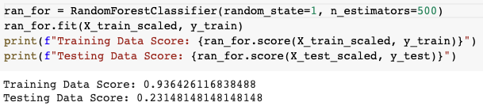
Model Performance
Feature Importances
Logistic Regression
Random Forrest Classifier
Results: Out of the two models tested the Random Forrest Classifier has achieved a better all-around result. Training score of 94% and a testing score of 23%.
Notes:
Nicolas

Slide 6
How Can We Improve the Model
Avoid overfitting
Increase the number of features
Financial data
Population data
Consider smokeless tobacco
Is the data too broad?
Consider other groupings other than by country
Notes:
Neal

Slide 7
Conclusion
This model could be utilized by health departments to target smoking cessation programs
More data/features are needed to gain better insight into cigarette consumption to better predict our goal
Consider other model architectures for improvement in accuracy
Notes:
Neal

